Slide 1
Online Course Registration and Waitlist System
Robert Sadowski
CST499: Capstone for Computer Software Technology
Dr. Charmelia Butler
16 March 2026

Slide 2
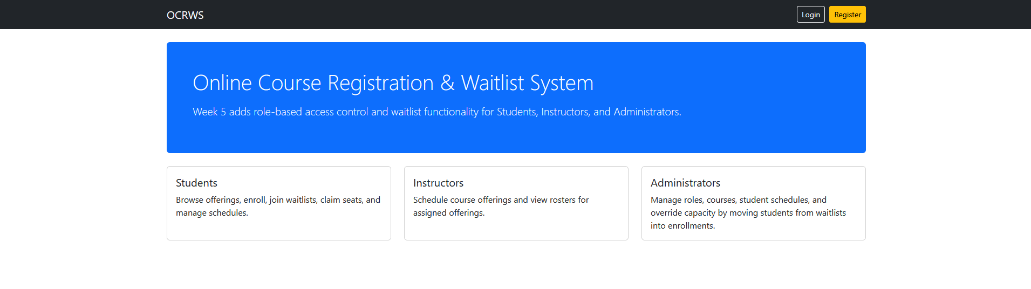
Project Overview
Purpose:
Build a role‑based course registration system.
Features:
• Student enrollment
• Waitlist management
• Instructor course management
• Administrator overrides

Slide 3
SRS Summary
Key Requirements:
Unique user registration and login
Semester‑based course offerings
Enrollment limits
Waitlist functionality
Role‑based permissions

Slide 4
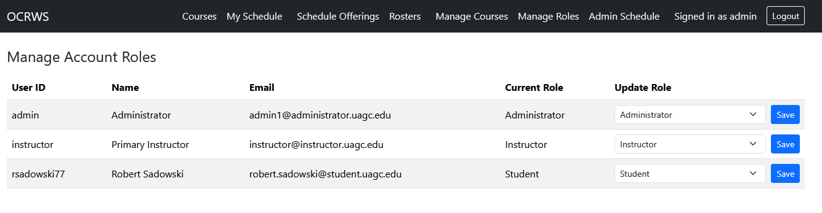
System Roles
Students
Enroll/drop courses
Instructors
Manage offerings & view rosters
Administrators
Manage roles and override capacity

Slide 5
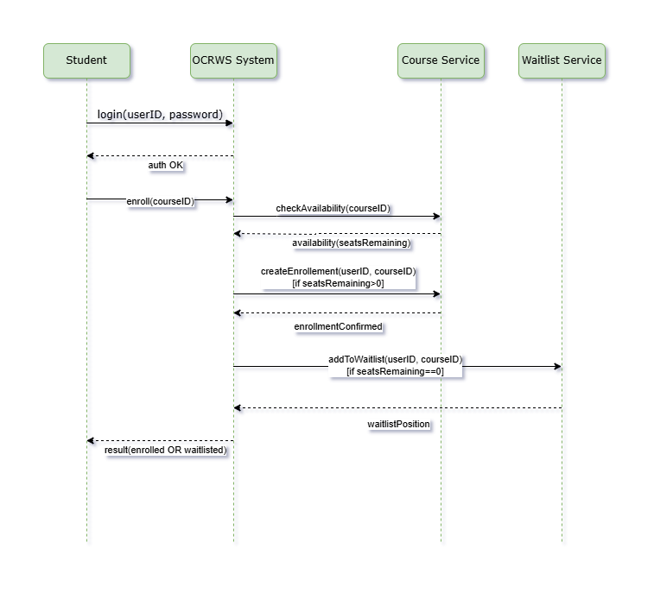
UML Design Model
UML diagrams used:
Use Case Diagram
Class Diagram
Sequence Diagram
Activity Diagram
State Diagram

Slide 6
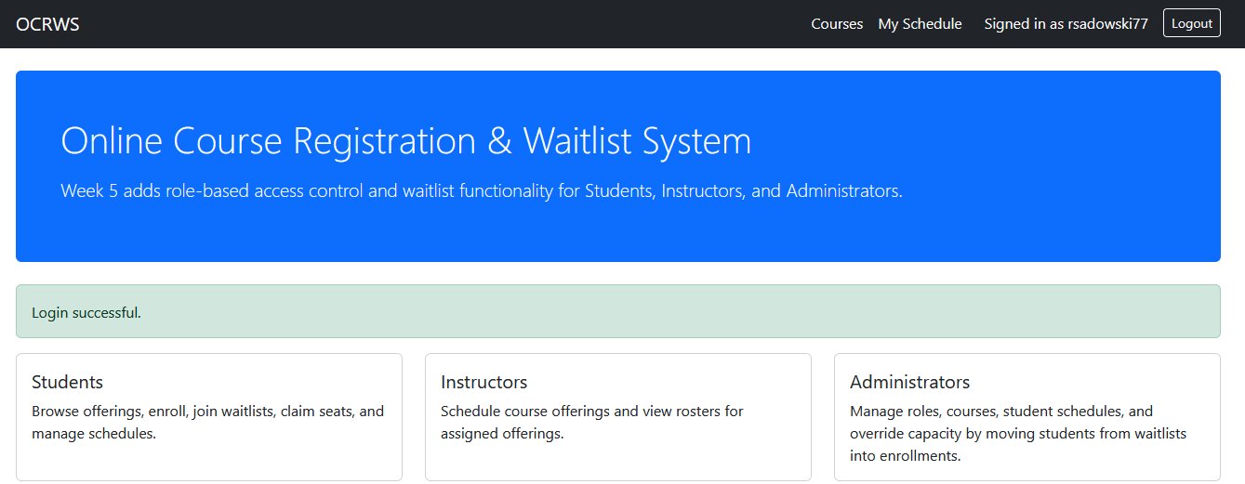
Landing, Login, Registration
Frontend pages developed using PHP and Bootstrap.
Features:
Secure login
User registration
Session authentication

Slide 7
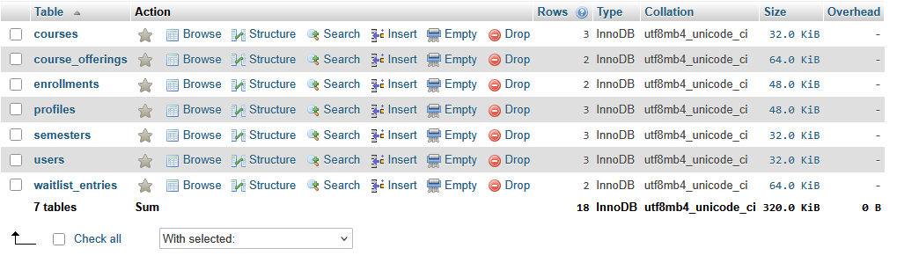
Database Design
MySQL database includes tables:

Slide 8
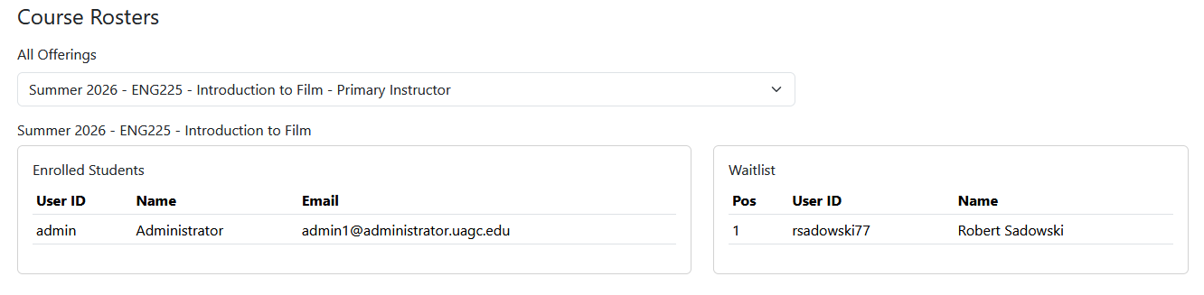
Waitlist System
Waitlist features:
Students join waitlist if course is full
Automatic promotion when seat opens
Administrator override enrollment

Slide 9
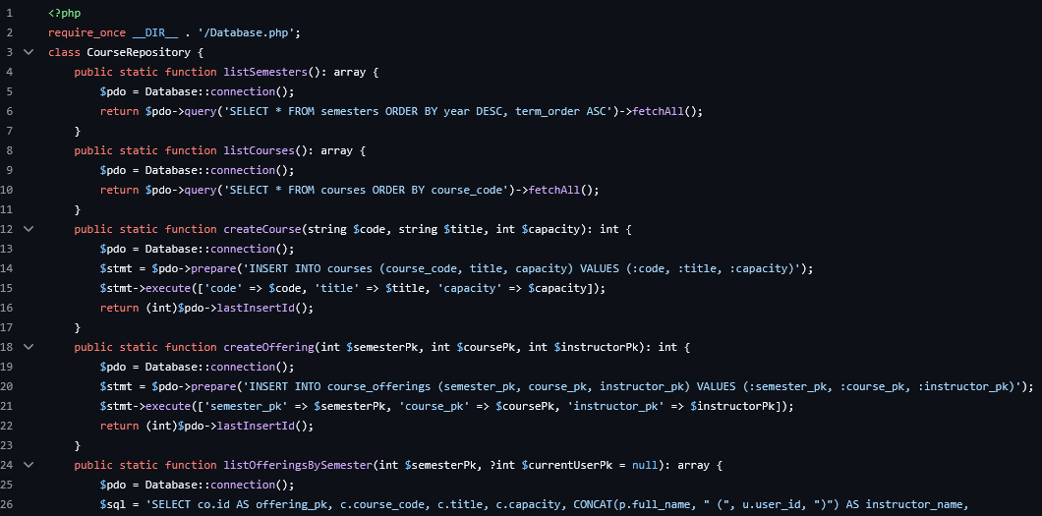
PHP Backend Logic
Core PHP components:
Repository pattern
Prepared SQL queries
Role‑based access control
Transaction management

Slide 10
Testing Strategy
Requirement | Functionality
User Registration | Verify unique user ID creation and profile storage
Login Authentication | Verify valid login and rejection of invalid credentials
Course Enrollment | Verify enrollment when seats are available
Schedule Viewing | Verify users can view their registered courses
Course Dropping | Verify users can remove courses from schedule
Waitlist Fill | Verify students are correctly added to course waitlist when full
Waitlist Draw | Verify courses automatically promote waitlisted students as seats open
Database Integrity | Verify correct data storage and retrieval
Testing approach:
Unit testing
Integration testing
System testing
Acceptance testing
Based on IEEE 829 test plan.

Slide 11
Project Outcomes
System successfully demonstrates:
Secure authentication
Role‑based permissions
Dynamic course registration
Waitlist automation
Future improvements:
Email notifications
UI enhancements
Automated testing

Slide 12
References
Tsui, F., Karam, O., & Bernal, B. (2018). Essentials of Software Engineering (4th ed.). Jones & Bartlett Learning.
Myers, G., Sandler, C., & Badgett, T. (2011). The Art of Software Testing.
Connolly, R., & Hoar, R. (2022). Fundamentals of Web Development (3rd ed.). Pearson.

